Slide 1
CREDIT RISK ANALYSIS

Slide 2

INTRODUCTION
Who is more likely to default on a loan?

Slide 3
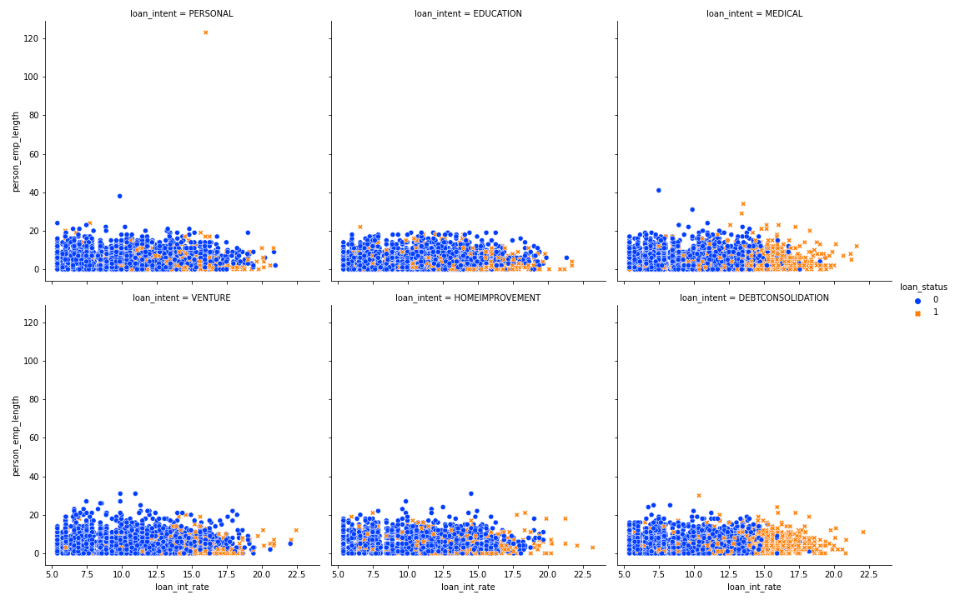
Profit Analysis
Loan Intention Analysis
From the plot it's clear most customers years of employment is between zero and twenty.
No clear relationship between loan interest rate and number of years one has been employed.
Most customers tend to default on loans whose interest rate is high especially those whose intent is DEBTCONSOLIDATION and MEDICAL bills.

Slide 4
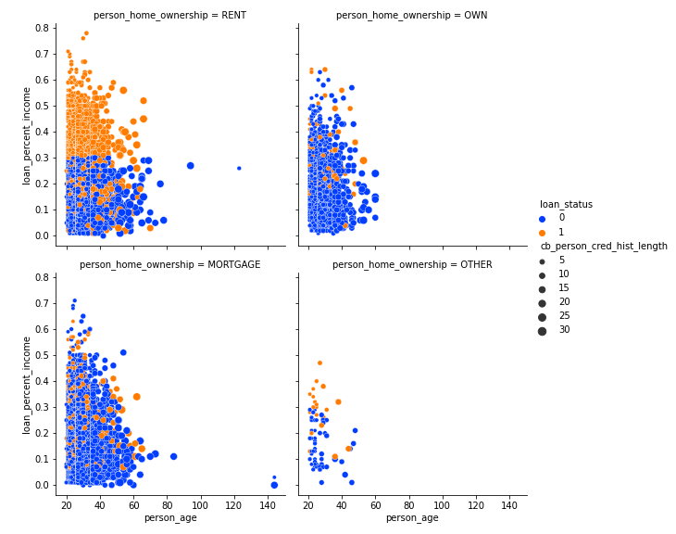
Home Ownership Analysis
Still no clear trend between a customers age and loan percent income variable. In all categories of home ownership, there are more loan defaulters on customers whose loan percent income is higher but more persistent on customers whose home ownership is RENT.

Slide 5
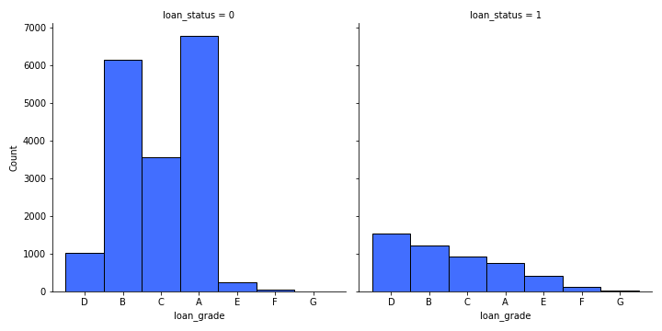
Loan Grade Analysis
People categorized as loan_grade A are the majority non-defaulters and those grouped in D more likely to default than any other group.

Slide 6
Recommendations
The bank should give less loans to loans that have a high interest rate especially to those whose intention is cover their medical bills or settle other debts. They are more likely to default.
The bank should avoid customers whose loan percent income is above 0.25 . Those whose home ownership is rental and loan percent income is above 0.25 should be avoided since most of them default on the loans.
If the above factors are considered , and a customer’s loan grade falls into category A , B or C , these customers are good candidates for loans.

Slide 7
Thank You

